Slide 1

Department of Information and Communication Technology
Mawlana Bhashani Science and Technology University
Santosh,Tangail
Course Title: EDGE ICT - Python -DJango
Presentation Title:Egg Prediction Project-A Machine Learning Application for Agricultural Insights
Presented to
Dr Ziaur Rahman
Associate professor
Dept.of ICT,MBSTU
Presented by
Mst.Mostary Khatun
ID-IT20036
Dept.of ICT,MBSTU

Slide 2
Table of content
Introduction
Objective
Project Overview
Machine Learning Pipeline
Flask Web Application & Screenshort
Challenges and Solutions
Conclusion

Slide 3
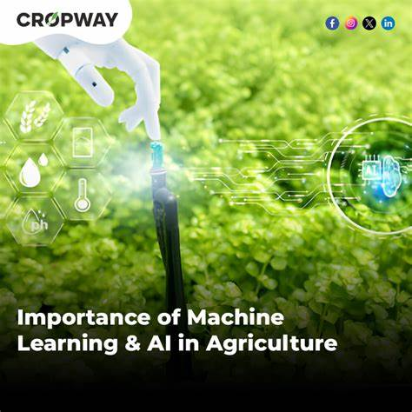
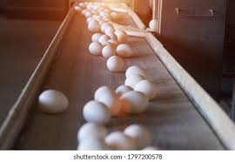
Introduction
The Egg Prediction Project leverages machine learning techniques to predict key metrics of egg production.
Aimed at improving efficiency and decision-making in the poultry industry.
Combines data analytics and a web-based interface for accessibility.
Importance of Egg Prediction:
Egg production is influenced by various factors like feed, environment, and hen health.
Predicting egg production helps farmers plan better, reduce wastage, and maximize profitability.
Key Takeaways:
Understand the process of building a machine learning model.
Learn about its applications in agriculture.
Discover how technology can revolutionize productivity in the egg production industry.

Slide 4

Objective
Content:Primary Goal: To predict egg production metrics using machine learning algorithms based on various input features (e.g., weight, size, shell characteristics).
Secondary Goals:
Enhance agricultural insights for farmers.
Provide a user-friendly web application for predictions.
Reduce resource wastage through accurate forecasts.

Slide 5
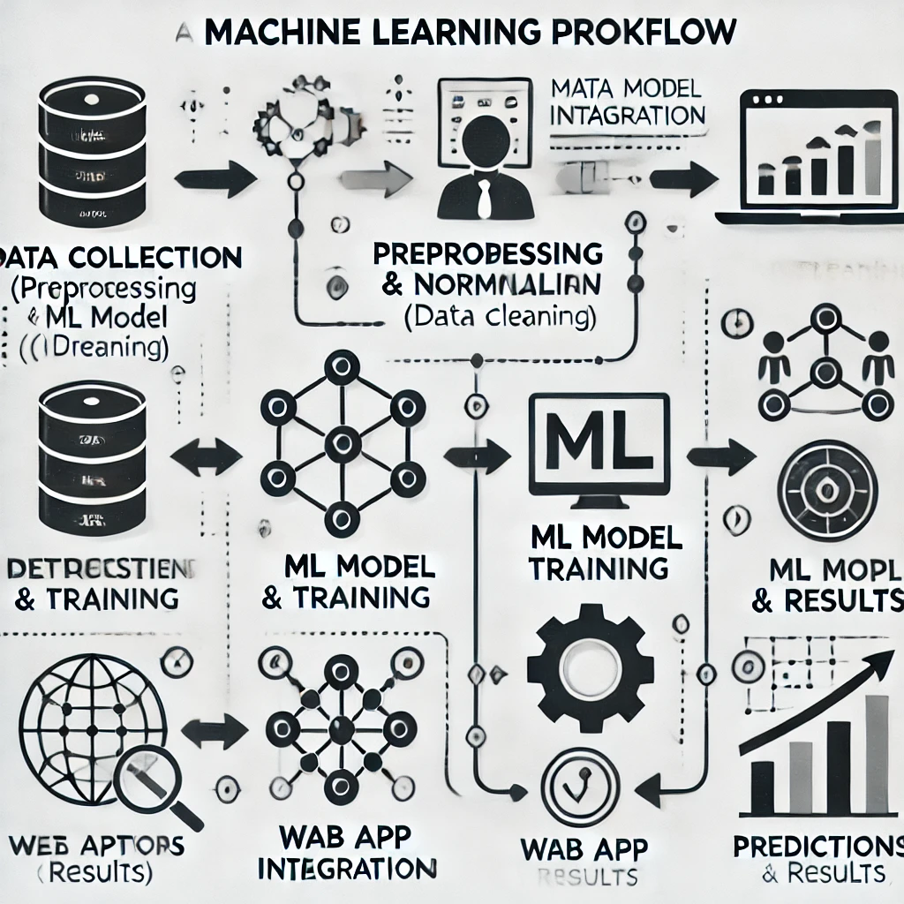
Project Overview
Content:
Key Features:
Preprocessing of agricultural datasets.
Development of a machine learning pipeline.
Deployment via a Flask web application with interactive UI.
Tech Stack: Python, Scikit-learn, Flask, HTML/CSS, Pandas.
End Users: Farmers, agricultural researchers, policymakers.

Slide 6
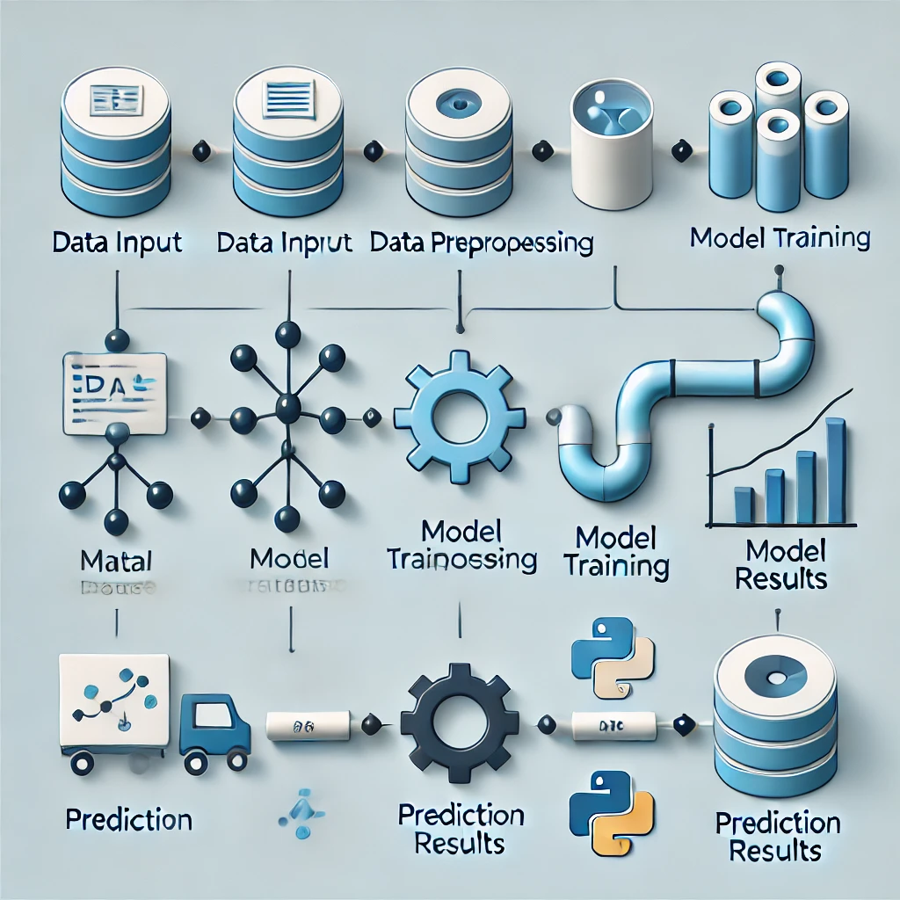
Machine Learning Pipeline
Content:
Steps Involved:
Data Collection: Gather agricultural data (e.g., egg weight, shell color, etc.).
Data Preprocessing:
Handle missing values.
Standardize features using standardScaler
Model Training: Train a Random Forest Classifier for accurate predictions.
Evaluation: Assess model performance using accuracy, precision, and recall metrics.
Model Deployment: Save the trained model as a .sav file for Flask integration.

Slide 7
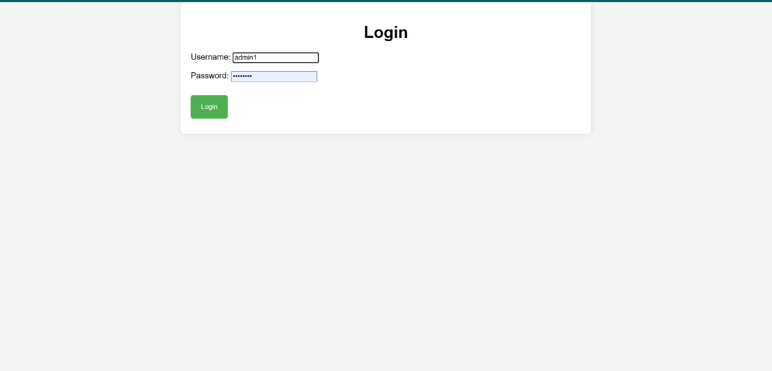
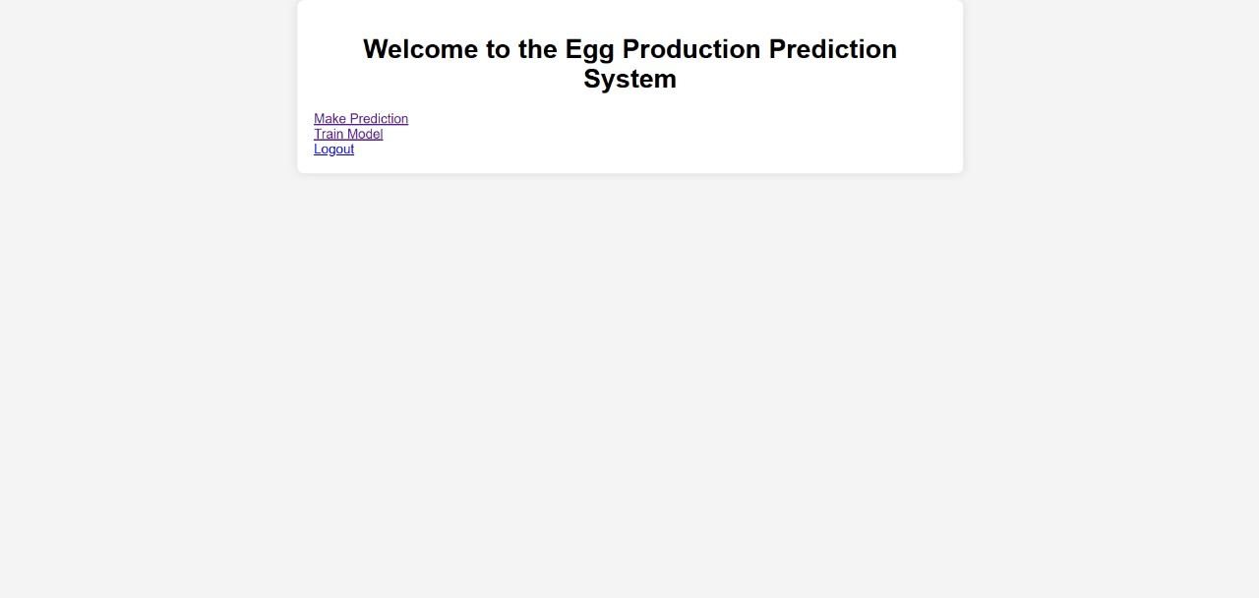
Flask Web Application & Screenshort
Content:
Purpose: Integrates the ML model into a user-accessible web application.
Key Functionalities:Input data through forms.
Predict egg production metrics.
Display results in real time.
Endpoints:
/Train-For model training.
/Predict-For making predictions.

Slide 8
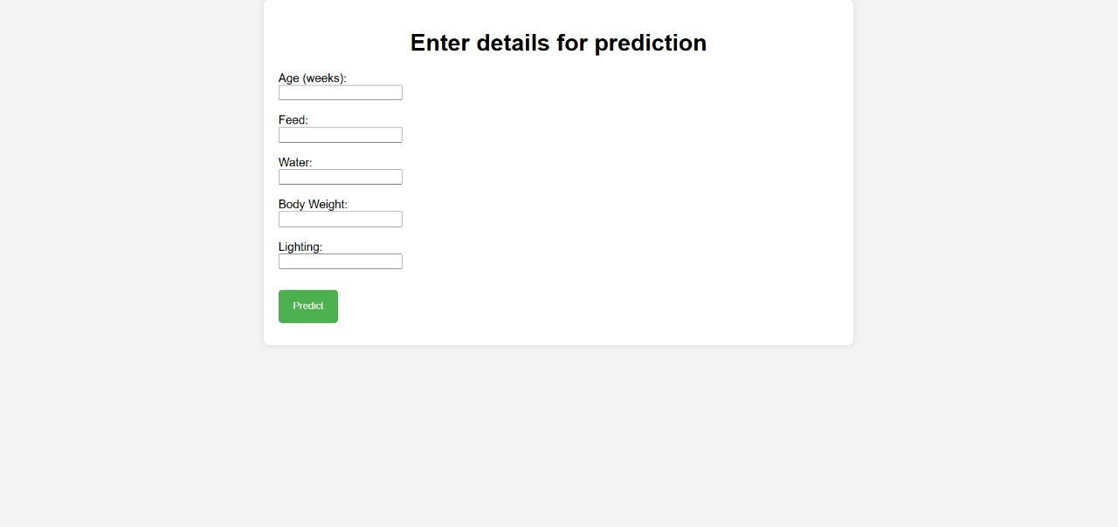
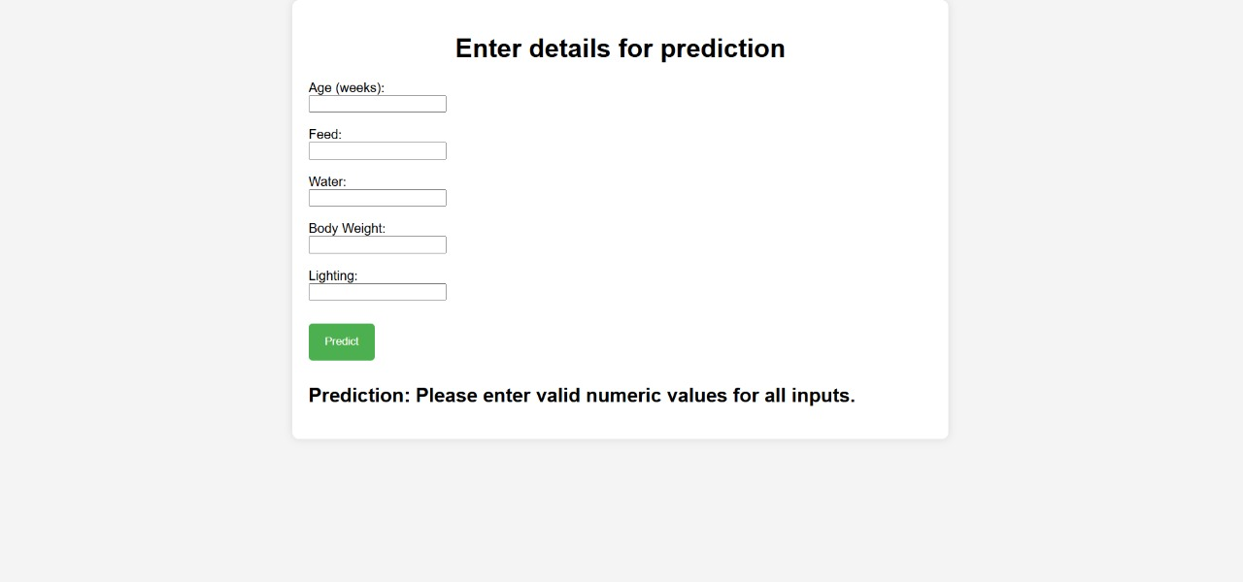
Flask Web Application & Screenshort

Slide 9
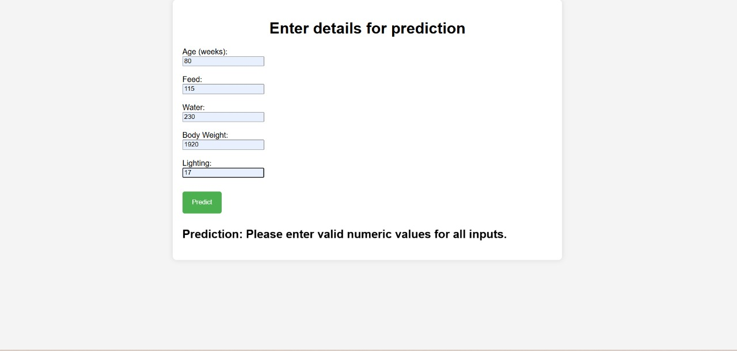
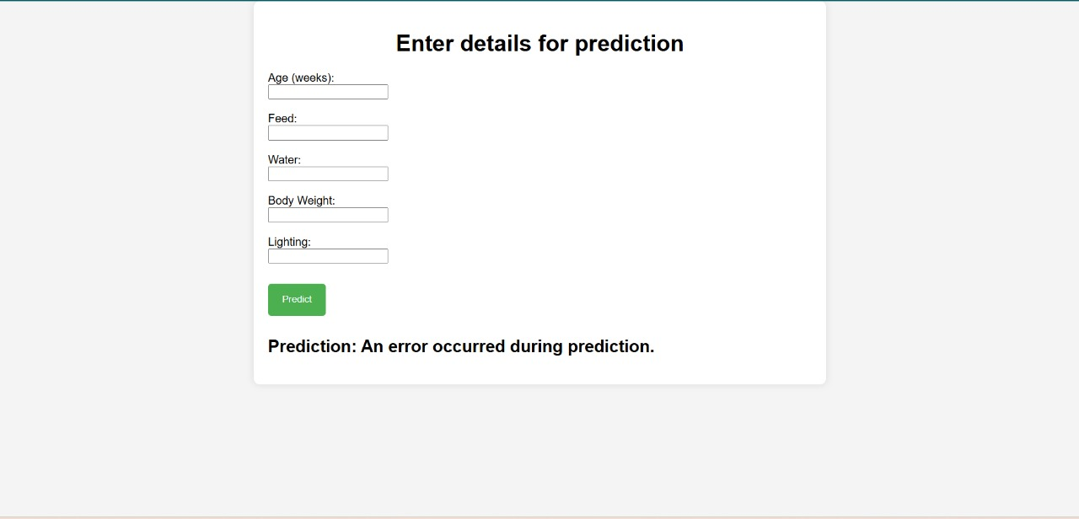
Flask Web Application & Screenshort

Slide 10
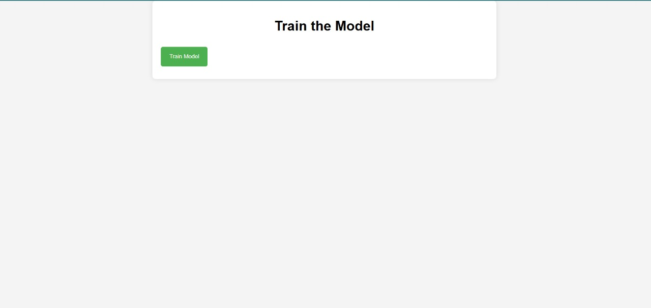
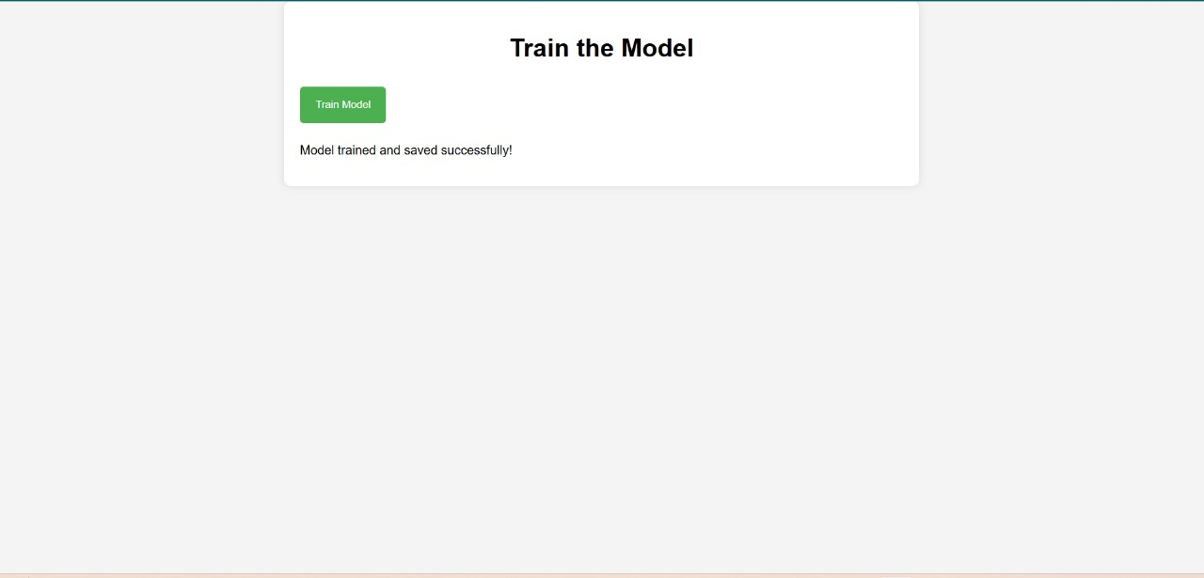
Flask Web Application & Screenshort

Slide 11
Challenges and Solutions
Content:
Challenges:
Noisy and incomplete data.
Model overfitting during initial iterations.
Deployment hurdles during Flask integration.
Solutions:
Applied robust data preprocessing techniques.
Used cross-validation to minimize overfitting.
Resolved deployment issues with testing on local servers.

Slide 12
Conclusion
Content:
Successfully developed and deployed an ML-based web app for egg production prediction.
Achieved high model accuracy and user-friendly design.
Provides actionable insights for the agriculture industry.
Call to Action:
Explore the project on GitHub: [https://github.com/MostaryKhatun/ML_project_Egg_Prediction].
Collaborate for future enhancements.

Slide 13
THANK YOU

